Slide 1
CSS - Box Model
CTEC 130

Slide 2
The Box Model

Slide 3
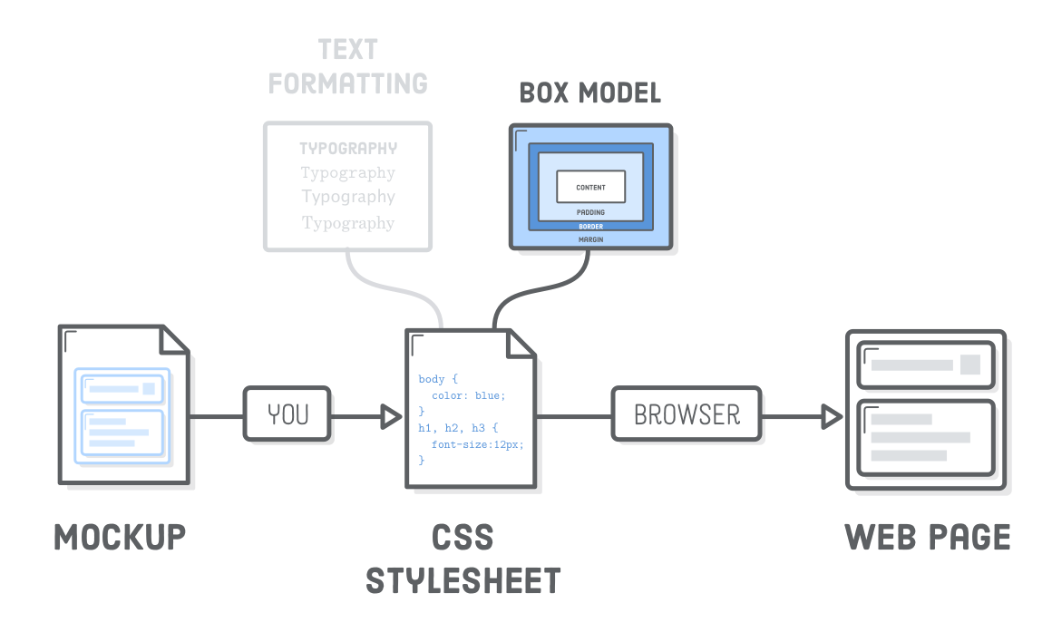

Slide 4
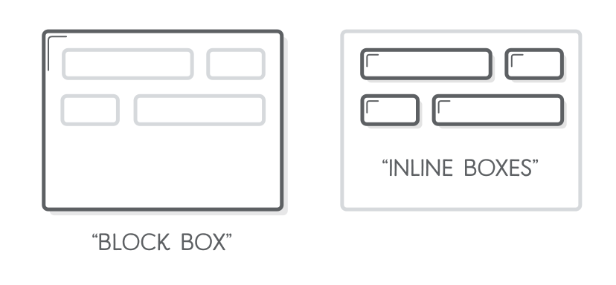
Block and Inline Elements
Block elements
Always appear below previous block element by default
Width is set automatically based on width of parent
Height is set automatically based on content
Inline elements
Don’t affect vertical spacing
Width is based on content
We can change the display type of elements via CSS

Slide 5
The display Property
A CSS property that can change how an element is displayed
Some Options:
display: block
display: inline
Display: inline-block
display: none
There are many more, but these are mostly what you’ll use for now

Slide 6
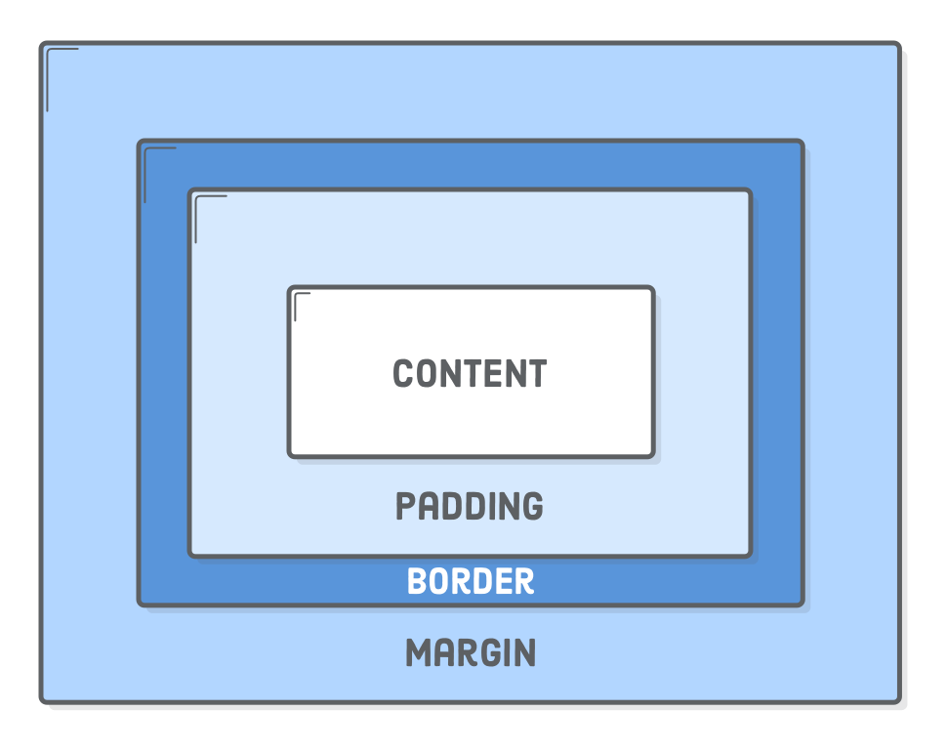
How a Block Displays

Slide 7
Box Sizing
The size of an element is determined by adding up all of its features
Width
Padding
Border
Margin

Slide 8
Padding
Space “inside” the element around the content
Can set a value for padding on all 4 sides:
padding: 40px;
Can set sides specifically:
padding-left: 20px; padding-top: 10px; padding-bottom: 15px; padding-right: 30px;
Can write in shorthand:
padding: 20px 10px; /* Vertical Horizontal */

Slide 9
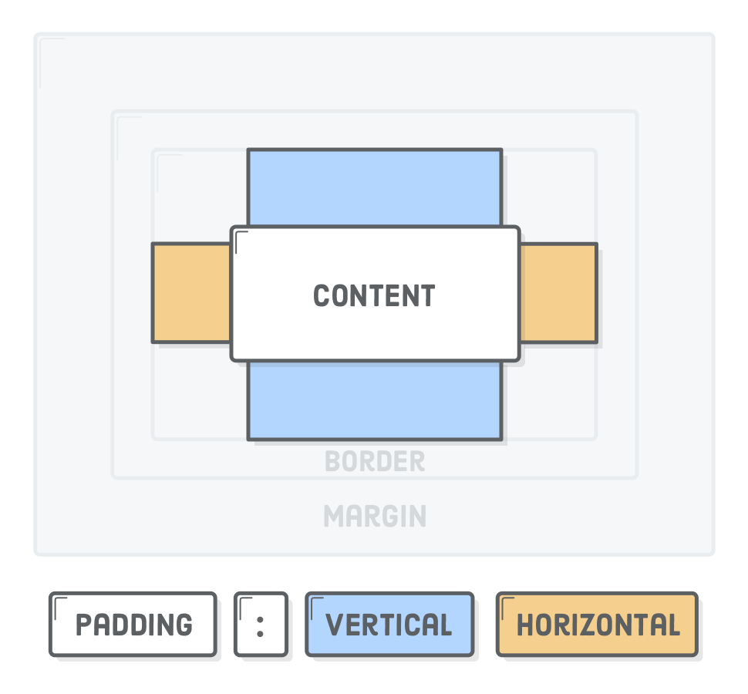
Shorthand Format: Vertical and Horizontal

Slide 10
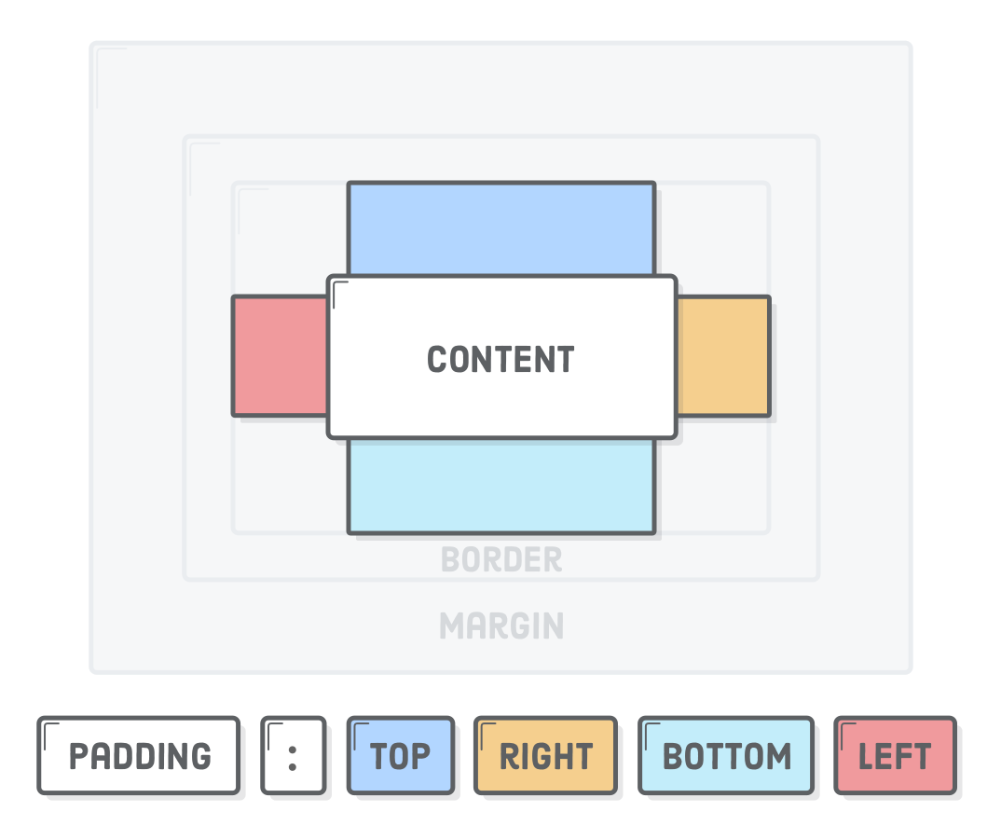
Shorthand Format: All 4 Values

Slide 11
Margins
Space “outside” of the element
Differences from Padding:
Margins are invisible, Padding absorbs background color
Paddings are included in click area, Margins aren’t
Margins collapse vertically, Padding doesn’t
Setting Margins looks a lot like setting Padding

Slide 12
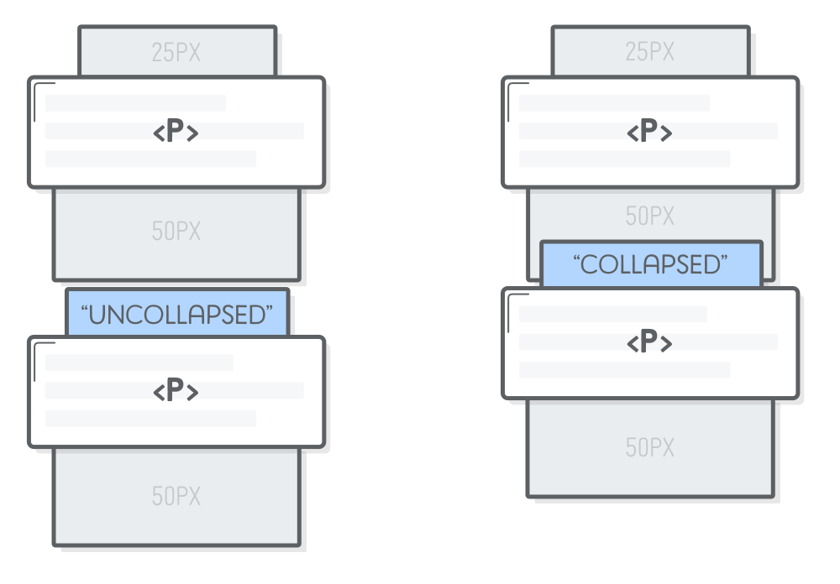
Margin Collapse

Slide 13
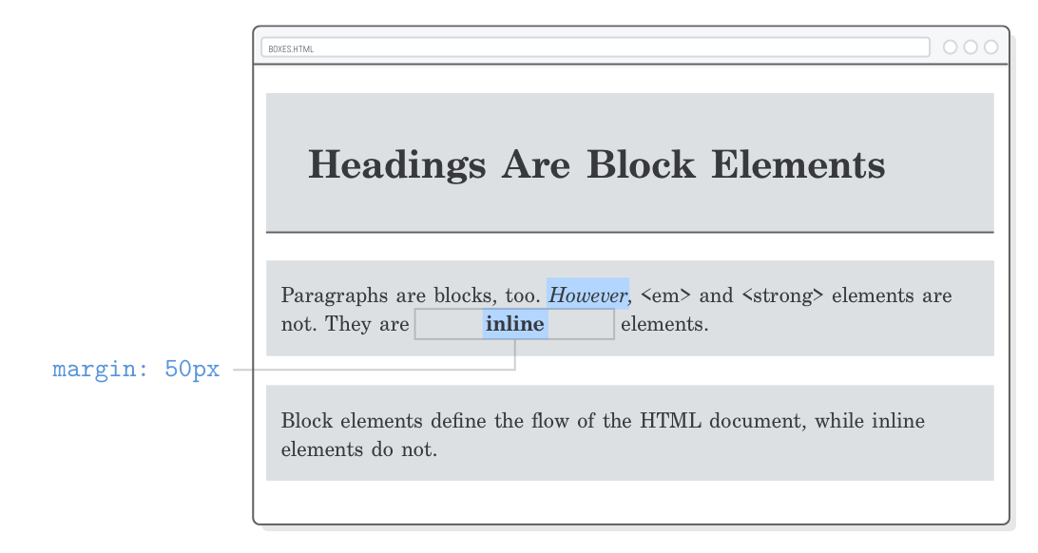
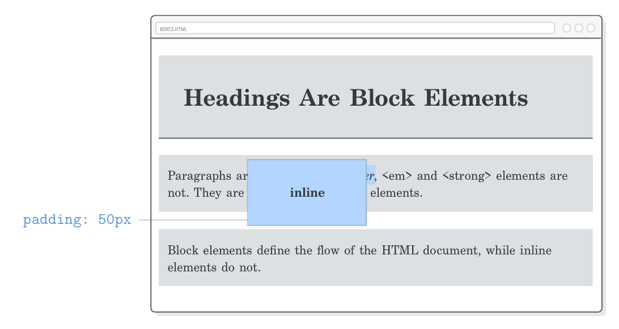
Inline Elements: Margin and Padding
Margin and Padding can have different results on Inline elements
Vertical margins are not applied to inline elements, only horizontal
Padding is applied, but doesn’t affect position of an inline element
Remember you can change the display type via CSS

Slide 14
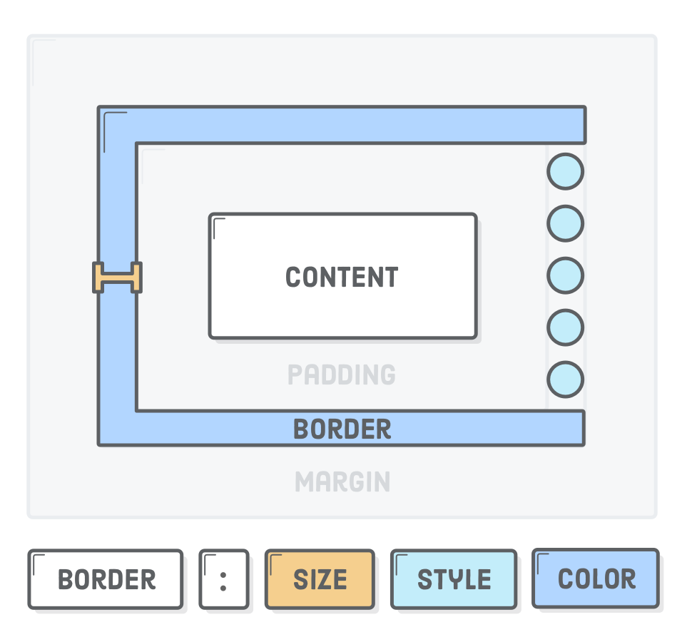
Borders
Usually added as a decorative element
Draws a line around the content
Syntax:
border : 1px solid black;
Can also specify border-bottom, border-top, etc.
Some Styles:
solid
dotted
dashed
none
And many more

Slide 15
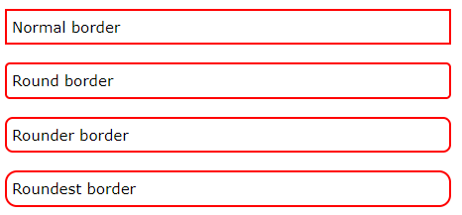

Rounded Borders

Slide 16
Borders Continued
Instead of writing shorthand, you can also specify different border values separately
border-style
border-top-style
border-bottom-style
border-right-style
border-left-style
border-width
border-color
border-top-right-radius

Slide 17
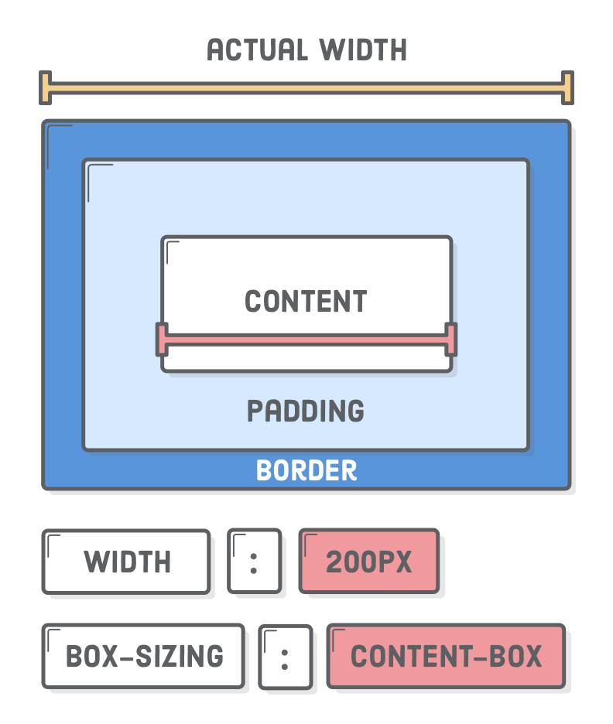
Dimensions
You can directly set the width and height of block elements with the width and height properties
The width and height provided change the “content” size part of the box model but doesn’t include margin, padding or border size

Slide 18
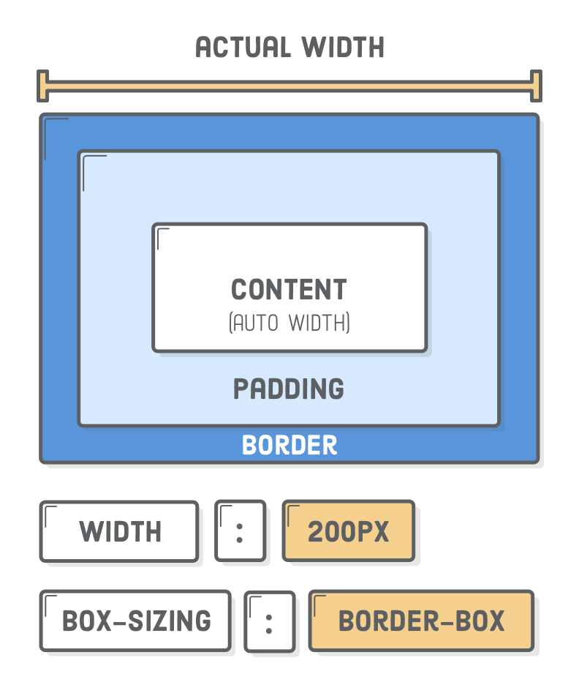
Border-Box
If Content-Box sizing is confusing to you, you can switch to Border-Box via the box-sizing property in CSS

Slide 19
Floating Boxes
You can apply float to Block-Level elements to arrange them
This was the primary way to layout page elements before tools like Flexbox and Grid, which we’ll talk about later

Slide 20
Centering with Auto-Margins
One neat CSS trick is centering a block-level element via the margin property
If you set both margin-left and margin-right to auto, the margins will extend to fill the page, centering the box

Slide 21
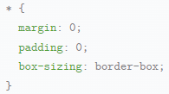
CSS Reset
Different browsers apply different default styles to a page
Before you apply your styles on top of these, it can be a good idea to “reset” the styles to some default
This is often accomplished by a “reset” or “normalize” stylesheet
https://necolas.github.io/normalize.css/8.0.1/normalize.css
Or you can apply a reset style

Slide 22
Background Styles

Slide 23
Background Styles
Along with modifying positioning, we can also add colors and images to our sites via CSS
If you want to use images to decorate your site, CSS is the best way to do so
Images that are part of your content should remain in your HTML

Slide 24
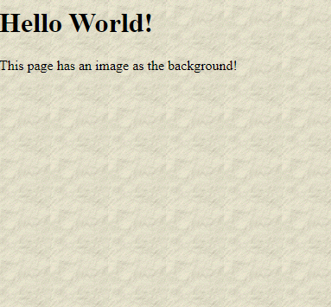
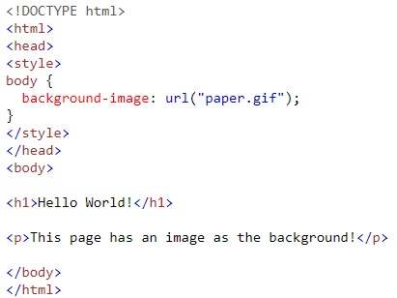
Background Image

Slide 25
Background-Repeat
background-repeat
Controls how and if the image repeats
repeat-x
Background repeats only on x axis
repeat-y
Background repeats only on y axis
repeat
Repeats on x and y axis
no-repeat
Doesn’t repeat

Slide 26
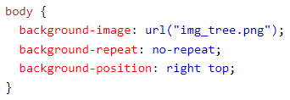
Background-Position
Specifies position of background image

Slide 27
Background-Attachment
The background image can scroll with the content, or be fixed to the browser window
background-attachment: fixed;
Content floats above background image as you scroll
background-attachment: scroll;
Background moves with content

Slide 28
CSS Gradients

Slide 29

Gradients
A fancy term in design that refers to a set of colors that fade into one another
In the bad old days we had to use images if we wanted some color gradient on a page, but now we can do it with CSS

Slide 30
Gradient Syntax
Set as a value for background or background-image
Can be used anywhere in CSS where an image is expected
Three types:
Linear-gradient
Radial-gradient
Conic-gradient
Is a CSS function that takes an optional direction and a list of colors
background-image: linear-gradient(to right, red, yellow)

Slide 31
More Gradient Details
Colors can be any supported color type
Red, rgb(255, 0, 0), #ff0000
If direction is left out, the linear gradient is top-to-bottom
Directions can be specific terms or degrees for finer controls
to bottom right, 45deg
You can do very complex things with gradients, including repeating patterns, but that’s outside the scope of this course
Look it up if you’re interested
While you could type all the details yourself, it’s easier to use other tools
https://cssgradient.io/

Slide 32
CSS Box Shadows

Slide 33
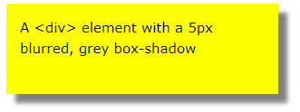

Shadows, but on Boxes
box-shadow works pretty much like text-shadow, but for block-level elements
Default color is current text color
Can pull the shadow inside of the block with “inset”
This makes it look like the block is below a hole cut out of the page

